Slide 1
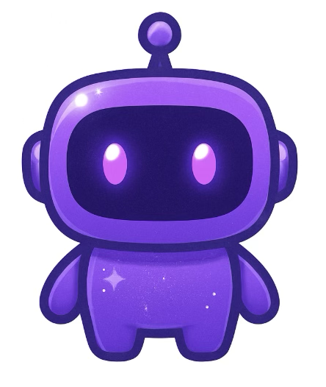
ChainMind ChatBot
Final Project - Ironhack AI Engineer Bootcamp
Sofia Zogkza

Slide 2
Overview
🔥 What I Built:
An autonomous AI tutor trained on expert YouTube videos about blockchain gaming. It learns the content, stores it in a vector database, retrieves the right information with RAG precision, maintains conversation memory like ChatGPT, and performs live internet searches when the videos don’t cover something.
Using agent reasoning and function-calling, it automatically chooses the best tool RAG, memory, or search to deliver clear, accurate explanations.
A fully end-to-end system, from data extraction to interactive UI, designed like the intelligent tutoring engines used in modern AI products.

Slide 3
Architecture Overview - Intelligent Video QA Pipeline
From raw videos to precise, real-time answers.
PROCESS FLOW:
YouTube Videos → Transcripts → Chunking → Embeddings → Pinecone Vector DB → RAG Engine → Agent Layer → Final Answer

Slide 4
RAG Engine
Indexing Phase (Offline / Pre-processing)
This part upserts transcript chunks into Pinecone:
Chunk text
Embed chunks
Store embeddings + metadata in Pinecone
It runs once (or whenever there is an updated). It is NOT part of the live chatbot.
Retrieval Phase (Online / Query-time)
This part runs every time the user asks a question:
Embed the user query
Retrieve top-k(7) relevant chunks from Pinecone
Pass them into the LLM to generate the final grounded answer
👉 This phase IS the actual “RAG engine”.

Slide 5
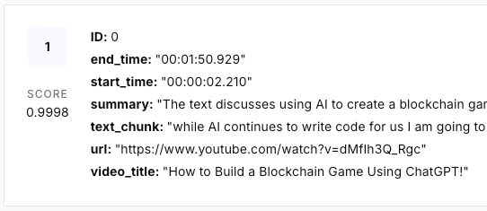
Example of stored chunk:
Actual metadata example:
The text-chunk brought better results than the summary at this point.

Slide 6
Agent Layer
Custom, lightweight agent in python | chooses between RAG, memory, and internet search (SerpAPI) based on logic
Retrieves accurate answers using a full RAG pipeline (Pinecone vector search + OpenAI embeddings).
Maintains conversational memory to understand context and keep conversations coherent.
Automatically detects follow-up questions and responds from memory without re-running RAG or search.
Falls back to internet search (SerpAPI) when RAG cannot answer, expanding knowledge beyond the dataset.
Uses OpenAI function-calling as an Agent to decide when to trigger external tools.
Combines RAG + Memory + Search into a hybrid intelligent agent, selecting the best source dynamically for each query.

Slide 7
Technical Summary
Dataset & Extraction: 4 YouTube videos |duration each 5-30 min | Blockchain related
Processing: yt-dlp caption extraction | cleaning: regex, normalization (NFKC), punctuation
Embeddings: text-embedding-3-small
Vector DB: Pinecone v7.3
LLM: gpt-3.5-turbo
Agent: gpt-4o-mini | Tools: SerpAPI live Google results
Memory: Custom | 5 last QA entries stored as conversational context | Follow-up detection with memory recall | Prompt injection
Frontend: Gradio v6 | Custom theme with css & js

Slide 8
Prompt Analysis
How the Chatbot Responds (What You See in Chat):
RAG: When the answer exists in the video knowledge base MEMORY: Used when the user asks a follow-up question AGENT: Used when RAG cannot answer. The agent triggers internet search via SerpAPI, processes the results, and returns a refined, up-to-date answer.
FALLBACK:Used when nothing else applies. If the model doesn’t call the search tool and RAG found no useful context, the system returns the default RAG message.

Slide 9
DEMO

Slide 10
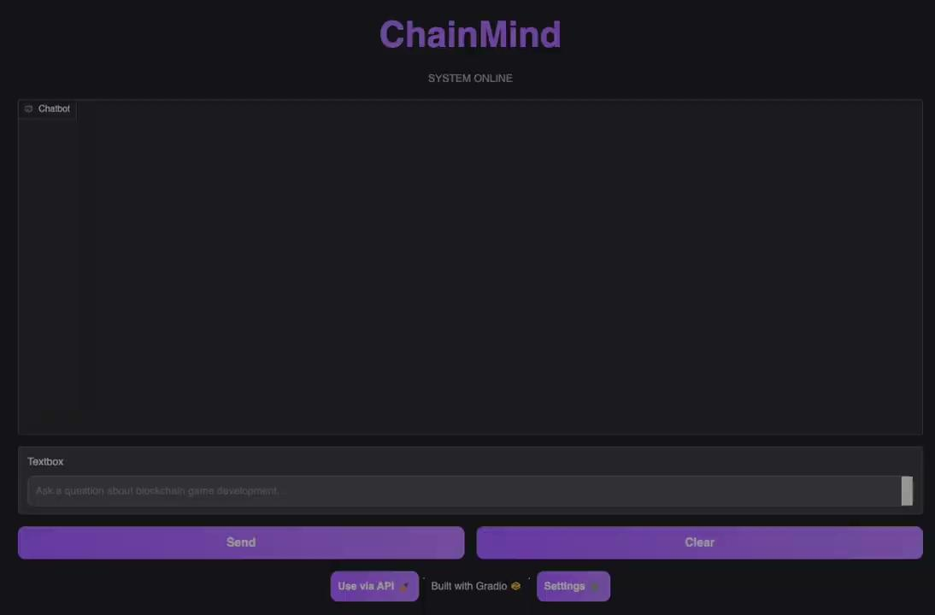

Slide 11


